Slide 1
The Oaktree School
Early Years Foundation Stage
Personal, Social and Emotional Development
Workshop

Slide 2
Personal, Social and Emotional Development
Personal, Social and Emotional Development (PSED) is recognised as one of the building blocks of success in life.
It supports children’s development by helping them to interact effectively and develop positive attitudes to themselves and others.
This does not happen in isolation and relies on influential adults such as parents and other familiar adults providing them with positive feedback and modelling appropriate behaviour.

Slide 3
Personal, Social and Emotional Development
PSED Early Learning Goals (ELGs)
Self-regulation
Managing Self
Building Relationships

Slide 4
Self Regulation
This goal helps children to develop confidence in who they are and what they can do, as well as expressing their own ideas.
We know that although many children have several people who care deeply about them all children need to have at least one person who is ‘on their side’ for them to really thrive.
This helps children feel valued and special and gives them a sense of self-worth. This in turn leads to them being confident with others and knowing when they need support from other people.
Early Learning Goal
Children at the expected level of development will:
- Show an understanding of their own feelings and those of others, and begin to regulate their behaviour accordingly;
- Set and work towards simple goals, being able to wait for what they want and control their immediate impulses when appropriate;
- Give focused attention to what the teacher says, responding appropriately even when engaged in activity, and show an ability to follow instructions involving several ideas or actions.

Slide 5
Self-Regulation Tips
Build your child’ ability to self regulate through providing opportunities for them to be –
Give time to children to self sooth. Sometimes they need time to reflect on a difficult situation before they are able to talk it through.
Give children strategies for staying calm in the face of frustration. Talk them through why we take turns, wait politely, tidy up after ourselves and so on.
Encourage them to think about their own feelings and those of others by giving explicit examples of how others might feel in particular scenarios.
Give children space to calm down and return to an activity.
https://www.youtube.com/watch?v=tXWztwxtdIg

Slide 6
Managing Feelings and Behaviour
This goal is about how children can understand their own and other people’s feelings, and how they learn to manage and self regulate their feelings without letting them spill out.
It also links to how children learn and follow simple rules which operate in different places such as home, a nursery setting or a play area.
Children need the support of adults to help them to understand these sometimes complex and often challenging areas.
Early Learning Goal
Children at the expected level of development will:
- Be confident to try new activities and show independence, resilience and
perseverance in the face of challenge;
- Explain the reasons for rules, know right from wrong and try to behave
accordingly;
- Manage their own basic hygiene and personal needs, including dressing,
going to the toilet and understanding the importance of healthy food choices.

Slide 7
Managing Feelings & Behaviour Tips
Offer constructive support and recognition of child’s personal achievements.
Have clear boundaries and stick to them
Promote sharing
Encourage children to express their feelings appropriately
Encourage children to adapt behaviours to different situations
Model how to negotiate and solve problems
Encourage restorative behaviour
Label the behaviour not the child – it’s the choice that was not good and not the child
https://www.youtube.com/watch?v=iGET9fNNlkw

Slide 8
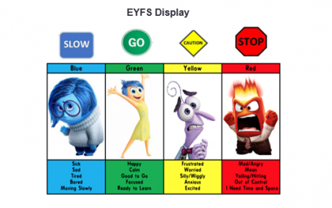
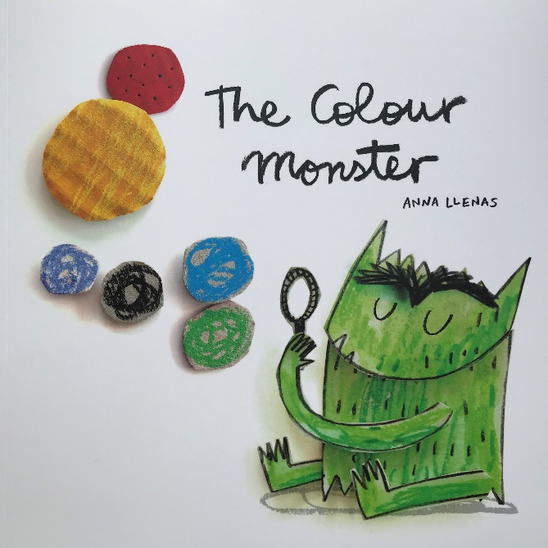
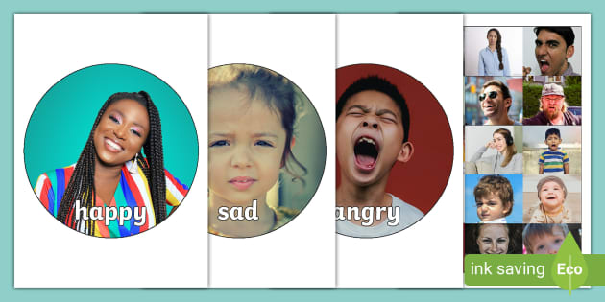
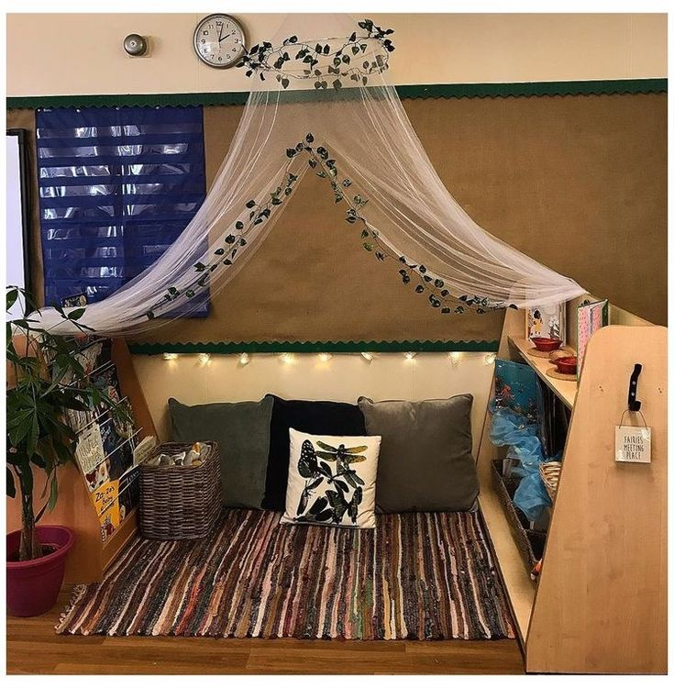

Slide 9
Building Relationships
This goal is about how young children learn to get along with other children and with adults
How they see something from somebody else’s point of view and take this into account when they play and work with other children.
It is also significant in developing friendships.
To be able to do these things children need role models – adults who show them how to be with others; how to be kind and to understand why people behave in certain ways – such as showing that they are sorry for hurting another person’s feelings.
This is one area in which many adults continue to struggle with since it is far-ranging and complex.
Helping children develop personally, socially and emotionally is often challenging but the benefits of this are life-long.
Early Learning Goal
Children at the expected level of development will:
- Work and play cooperatively and take turns with others;
- Form positive attachments to adults and friendships with peers;
- Show sensitivity to their own and to others’ needs.

Slide 10
Building Relationships Tips
Encourage and support your child to -
build relationships with special friends
interact with others
play alongside others
play co-operatively with others
show affection and concern for others
join in with others play
initiate play with others
take steps to restore conflicts
Takes account of what others say
https://www.youtube.com/watch?v=R-sv5mtcKMM
https://www.youtube.com/watch?v=XGZNFbozAnc

Slide 11
Phrases
Instead of… | Try…
I want…. | Please can I have.
No! | No thank you. You can have it next. You can have it when I’m finished.
It’s mine! He’s/She’s not sharing | No thank you. Please can I have it? I haven’t finished yet, you can have it when I’m done.
You are naughty! | That’s not a good choice. How can you make a good choice next time?

