Slide 1

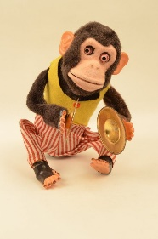
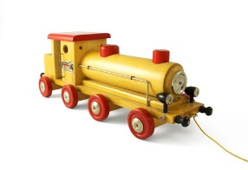
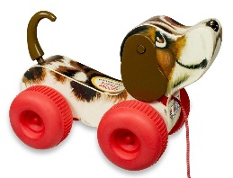
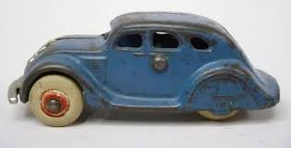
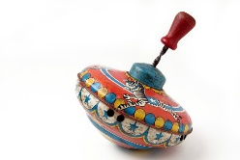

Understanding the World
This half term we will be…
Making observations about objects and artefacts from the past, such as toys, clothes and other items relating to everyday life.
Putting familiar events in chronological order, using pictures and discussion.
Recognising and discussing how they have changed from when they were babies.
Physical Development
This half term we will be…
Moving energetically and repeatedly, with improved fluency, control and grace when dancing and moving in time to music.
Showing accuracy and care when drawing.
Expressive Arts and Design
This half term we will be …….
Learning and singing songs and
rhymes as part of a larger group.
Constructing simple structures and models using a range of materials.
Creating collaboratively, sharing ideas and using a variety of resources to make products inspired by existing products, stories or our own ideas, interests or experiences.
What was life like for my grandparents?
Personal, Social and Emotional Development
This half term we will be…
Building constructive and respectful relationships by learning how to look after our special people and friends
Learning about being helpful at home and caring for our classroom and our world.
Learning about looking after money
Communication and Language
This half term we will be…..
Using age-appropriate software to create images and record sounds and videos.
Listening to and talking about selected non-fiction books to develop a deep familiarity with new knowledge and vocabulary.
Asking questions to find out more and understand what has been said to them.
Literacy- Reading and Writing
This half term we will be…
Using writing to communicate thoughts, ideas, experiences and events.
Talking about the pictures in story books and use them to discuss how characters might be feeling.
Talking about stories and make connections with events in their own lives or other familiar stories.
Rereading books to build up confidence in word reading, their fluency and their understanding and enjoyment.
Mathematics- Numbers and Shape, Space and Measures
This half term we will be…
Learning about mass and capacity
Exploring addition and subtraction with numbers to 10, using concrete objects, pictorial representations and number lines.
Counting objects, actions and sounds, up to 10 forwards and backwards, beginning at zero, one or any given number and link numerals with its cardinal number value.

Slide 2

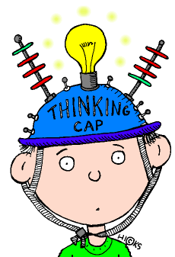



What was life like for my grandparents?
Key Vocabulary- Phonics
Blending- to pull together individual sounds or
syllables within words.
Segmenting- breaking words down into individual
sounds or syllables.
Phoneme- The smallest unit of sound. A sound a
letter makes.
Grapheme- a way of writing down a phoneme.
Home Learning Challenges
Select from the list below the activities that you would like to do as your home learning
challenges. You can present your challenges in any way. Have fun and be creative.
Spotting Changes
Look at photographs of your family from when you were a baby. How have you all changed?
Getting ready
Use the words first, next and then to draw a flowchart of your morning routine.
.
Key Vocabulary- Maths
Days, weeks, Monday, Tuesday, Wednesday, Thursday, Friday, Saturday, Sunday, adding, taking away, heavy, light, heavier, lighter, long, short, longer, shorter, tall, taller, full and empty, pounds, pence, coins,
Magical Memories
Talk about and draw your favourite memory. Can you add any words?
Family Stories
Talk to your grandparents about their past. What could you find out?
Winter Wonderland
Go on a wintry walk. Which signs of winter can you spot?
Family portrait
Draw and label a picture of your family. Who is the oldest/youngest?
Topic words:
Memory, remember, baby, toddler, adult, grow, history, grandparent, grandma, grandad, granny, grandpa, nana, family, sister, brother, aunt, uncle, cousin, history, heritage, history, past, historian.
Supporting learning at home:
Daily reading
Sound sheets- rehearsing letter formation
http://www.bbc.co.uk/schools/scienceclips/ages/5_6/science_5_6.shtml
http://www.phonicsplay.co.uk/ Phase 2 – game “Obb and Bob”
Cbeebies- Number blocks & Alpha blocks
Please keep PE kits in school. They will be returned at the end of each half term for washing.

